Slide 1
Firefox Rocks! Improve your productivity online
Jesse Wisnouse
Session 4- 2:45 to 3:30
Room 329

Slide 2
Meet the presenter
Middle school science teacher for Frederick Co. (MD) for four years (2002 - 2006)
Technology coordinator and technology education teacher for one year (2006 - 2007)
Technology Resource Teacher (2007 – present)
Assists teachers and students working with new instructional hardware and software
Researches, reviews, compares and recommends emerging technologies

Slide 3
What is Firefox?
Open source web browser from the Mozilla Corporation
Free to download and use on multiple computers
Works on PCs, Macs and Linux OS
Source code is available for developers
Quick stats
22.05% of browser market share, according to Wikipedia
Version 1.0 released in 2005 (currently on version 3.0.8)
New versions released frequently for security updates
PC World (2006) and CNET (2008) name it best browser

Slide 4
What is that significant?
Better security and performance
Constant updates and small patches for security
Browser less likely to be attacked
Smaller application to save and run
Quicker load time and less memory consumption*
Considered a mainstream program
700 million downloads (11/08); 220+ million users (1/09)
Second most popular browser behind Internet Explorer
Displays Virtually all websites properly or better

Slide 5
How to download Firefox
Go to a download site
www.download.com
Mozilla’s website
Download (save and then run) the file (under 10 MB!)
Program installs with desktop icon
Portable version (flash drives) available here

Slide 6
Where to go for help
Mozilla Firefox Knowledge Base and Forums
http://support.mozilla.com/en-US/kb/
http://www.mozillazine.org/
Groups dedicated to Firefox discussions
http://groups.google.com.au/group/Firefox-Users?hl=en
http://www.spreadfirefox.com/node/3015

Slide 7
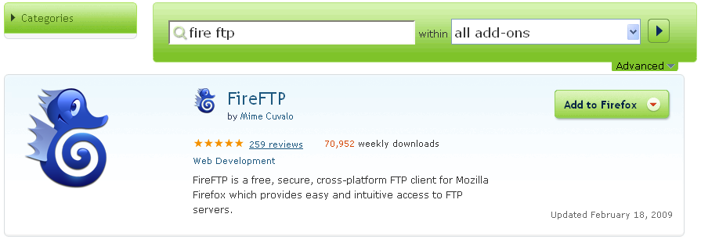
Customizing your version of Firefox
Download add-ons to improve performance, security and efficiency when multitasking (.xpi files < 1 MB)
Search by category, title, popularity or user rating
What kind of “stuff” can I use to fill my ‘fox?

Slide 8
Web-developer add-ons for Firefox
FireFTP
Firebug
Colorzilla
MeasureIt
IEView
Web Developer

Slide 9
Personal Efficiency add-ons
ScreenGrab
FavLoc
Colorful Tabs
PDF Download
Delicious bookmarking tool
Twitter bar
FEBE*

Slide 10
Possible school-based add-ons
Juice
Flashblock
Ad Block
No Script
Dictionary.com
WOT (web of trust)
Zotero

Slide 11
Tips for Installing Firefox Add-ons
Locate possible items you may want to install
PCWorld.com
SmartComputing.com
Lifehacker
Blogs and professional journals by trusted authors
View and review the item’s metadata at the download site
Evaluate and contribute back to the community- how did it work out?

Slide 12
In Summary… Firefox Rocks!
More secure and stable than Internet Explorer
Greater market share than all other browsers combined (Chrome, Safari, etc.)
Better support
Better peer user assistance
Websites with dynamic data are displayed properly
Add-ons allow you to personalize your experience
The power tools you add on save system resources
So, how can you contribute to the Firefox community?

